Slide 1
SLOVAKIA
Primary School Bernolákova 5,
Holíč

Slide 2
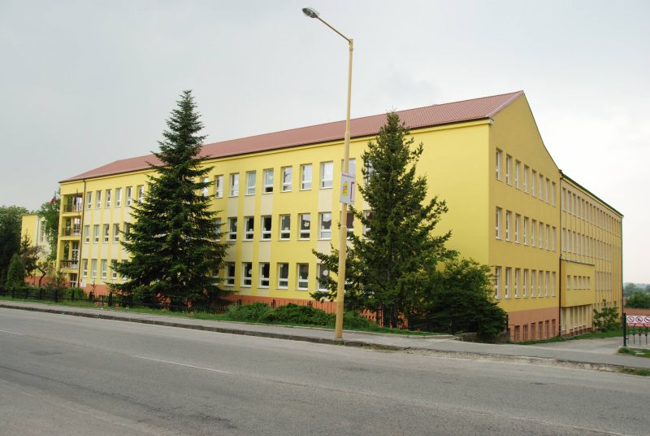
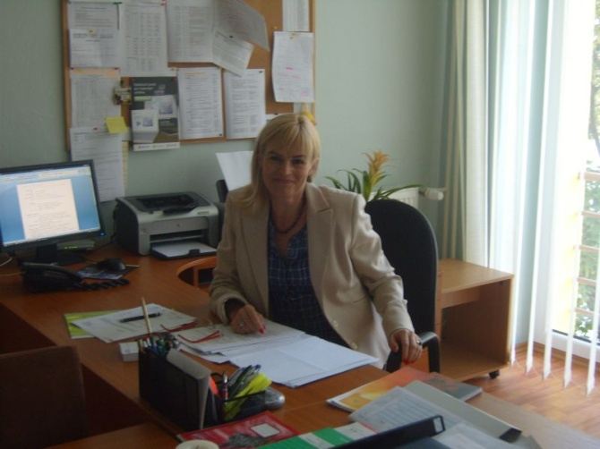
Primary School Bernolákova 5, Holíč
The building of the school

Slide 3
Primary School Bernolákova 5, Holíč
elementary education from pupil age of 6 -15
490 pupils at school
47 employees
children from 6 to 9 - 5 lessons a day
children from 10 to 15 - 6 lessons a day
School club – for sport and art activities

Slide 4
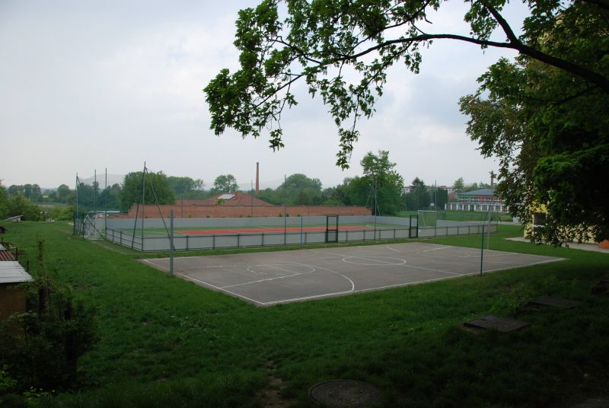
Primary School Bernolákova 5, Holíč
The school playground

Slide 5
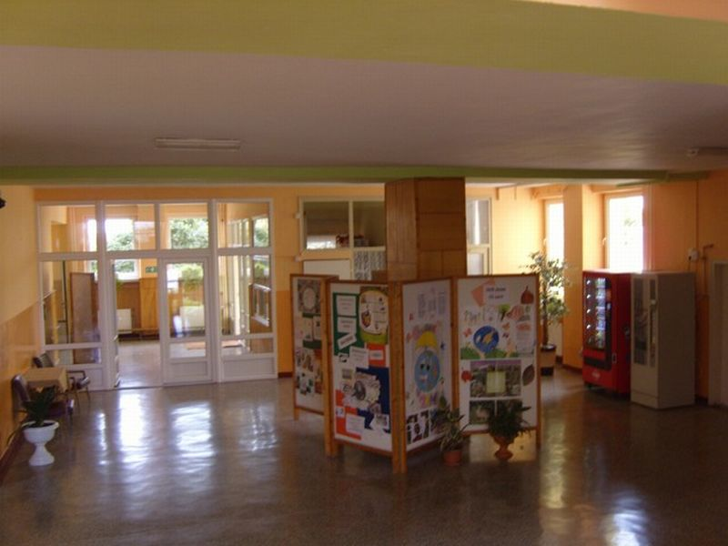
Primary School Bernolákova 5, Holíč
The school entry hall

Slide 6
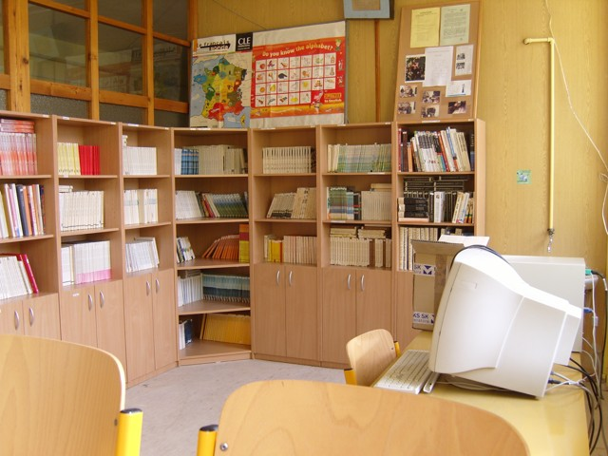
Primary School Bernolákova 5, Holíč
The school library

Slide 7
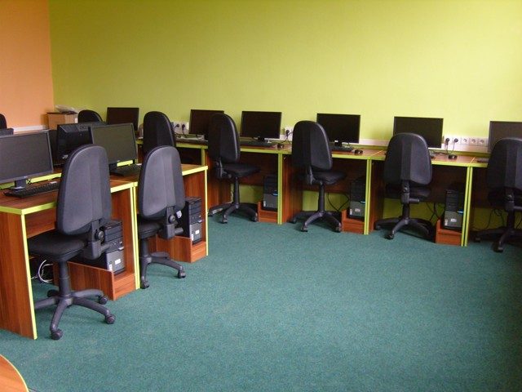
Primary School Bernolákova 5, Holíč
The PC class room

Slide 8
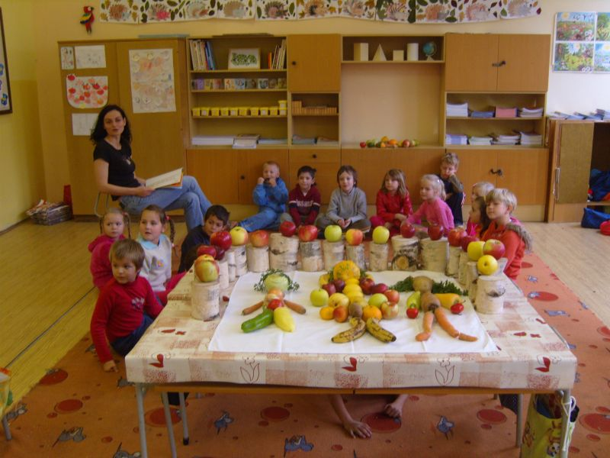
Primary School Bernolákova 5, Holíč
The healthy nutrition week

Slide 9
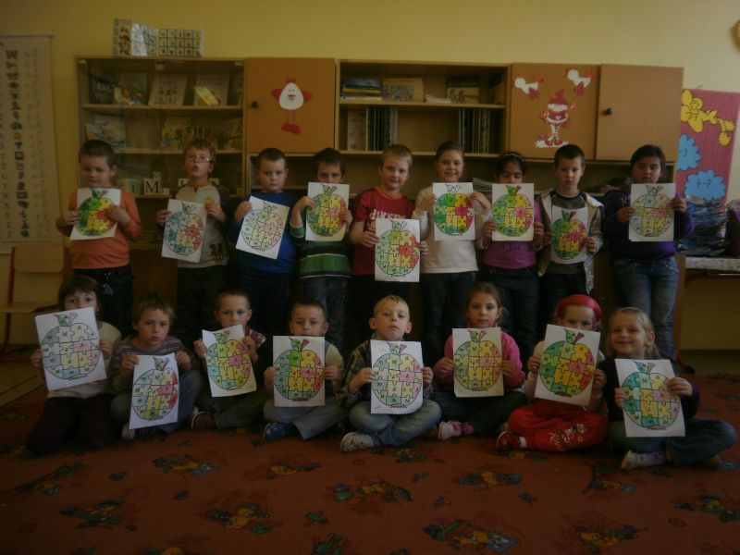
Primary School Bernolákova 5, Holíč
The Apple Day

Slide 10
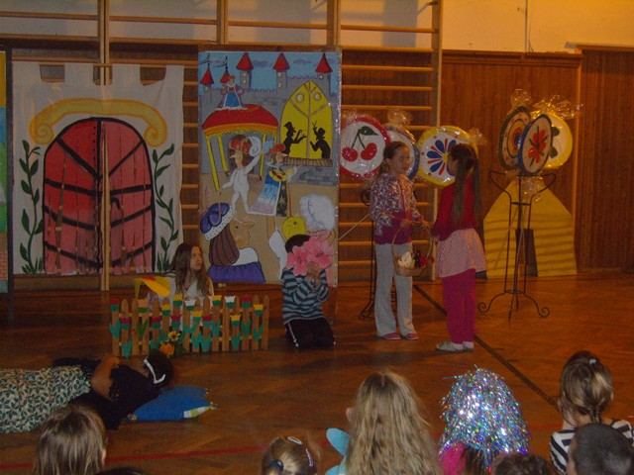
Primary School Bernolákova 5, Holíč
The fairy tale night at school

Slide 11
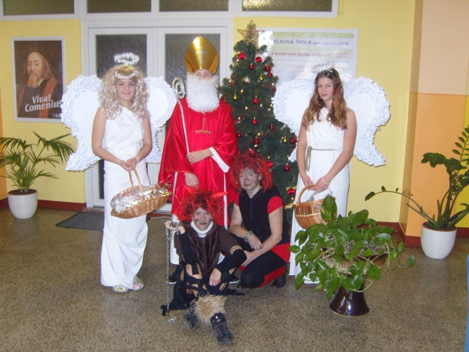
Primary School Bernolákova 5, Holíč
Christmas at school

Slide 12
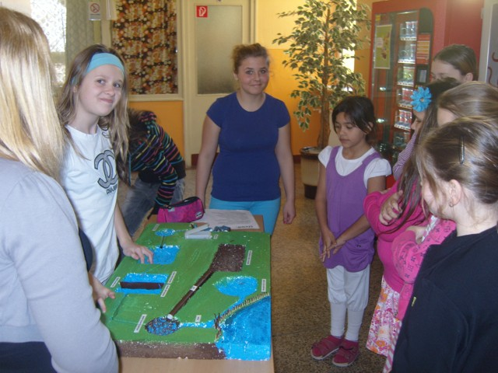
Primary School Bernolákova 5, Holíč
The Day of Water

Slide 13
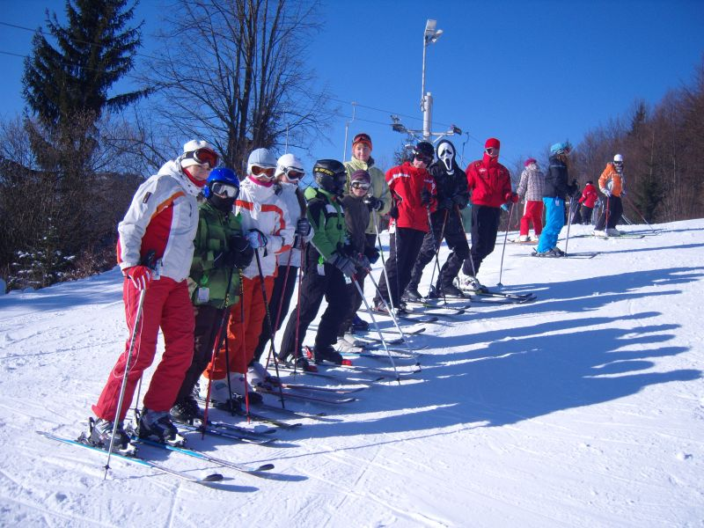
Primary School Bernolákova 5, Holíč
The skiing course

Slide 14
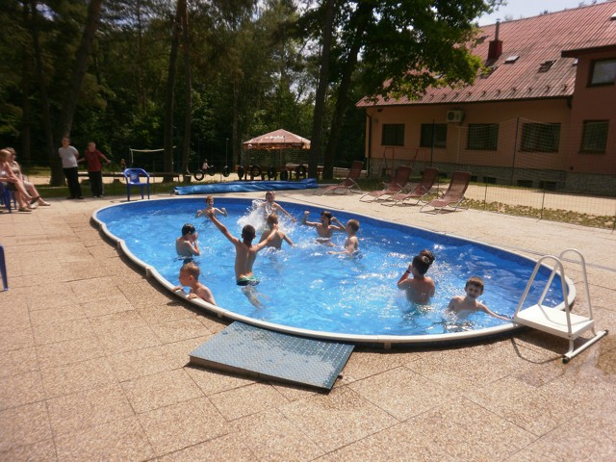
Primary School Bernolákova 5, Holíč
The school in the nature

Slide 15
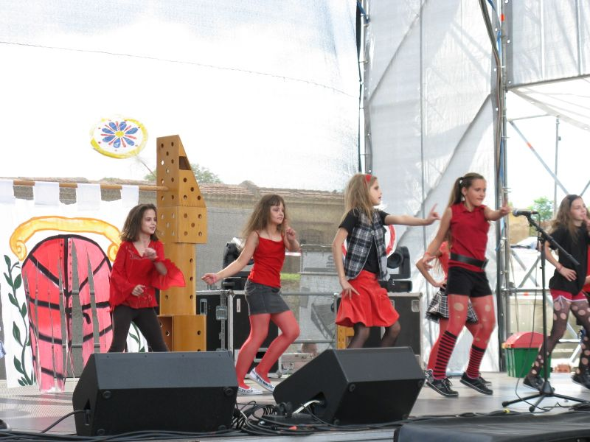
Primary School Bernolákova 5, Holíč
Traditions without borders

